Slide 1
Git, GitHub and version control

Slide 2
Git
Git is a version control system
A GitHub repository is a directory that the software git is using to keep track of versions
Install git, it's already installed on most cloud services
You can initialize a repository in a dir with the command git init (though we'll present a different workflow later
Your git repo then is a locally version-controlled system

Slide 3
Locally
Personally, I tend to initialize repos on github, then clone them locally
If you want to initialize the repo locally, it's as easy as this
cd PATH_TO_YOUR_DIRECTORY
git init
Or you can use the graphical utilities

Slide 4
Adding files
You can add files with the command
git add FILENAME
The file FILENAME is now staged to be part of the repository
Files that you haven't added won't be tracked
You only need to add the file once

Slide 5
Checking status
One of the most useful git commands is
git status
This gives the status of which files are being tracked, which are not and which have changes

Slide 6
Committing changes
You must commit your changes to the repository to have them represented
Committing changes is a local operation, subsequently, we'll show you how to coordinate with a remote repository
Here's the command I use to commit most often
git commit -a -m "COMMIT MESSAGE"
Here the flag -a means commit all files staged for commits. You can also commit individual files or a collection of specific files
The -m "COMMIT MESSAGE" is the message associated with your commit. Make your commit messages more informative. If you don't add -m github will bring up an editor for you to enter your commit message

Slide 7
Remote repositories
Git becomes much more useful when it's coordinated with a remote repository
Github is a server for hosting remote git repositories, there are several others, bitbucket is an example
Github also includes a great deal of functionality for working with the remote repository through the website
There's many git and github guis that you could use if you want. I always liked to github one and magit in emacs

Slide 8
Connecting your remote and local repos
You need to connect your local repo to the remote repo
First create a version of the repo on github (actually then it gives you instructions)
Then you can either
Clone the repo from the server git clone REMOTE SERVER
Connect the server to your local repository
git remote add origin git@github.com:USERNAME/REPONAME.git
Personally, I find it easier just to create the repo on github and clone it
You can clone over ssh or https, if you don't know what ssh is use https

Slide 9
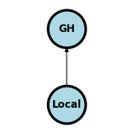
Pushing changes
You push from the repo you're working on to another (remote repo). So, for me, typically pushing from my computer repo to github
git push origin main
which could be read as "push my new committed changes from my origin to the main branch on my remote repo".
Older repos had the default branch master instead of main. But github switched in 2020 or so

Slide 10
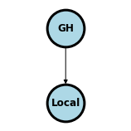
Pulling changes
There might be changes that you want represented locally that were changed on the remote repository; for example, you might edit a readme file through github's web interface
The command for this is really easy, it's just pull
git pull
The pain occurs if you have made local changes that are in conflict with the remote changes
Here's some docs on managing merge conflicts

Slide 11
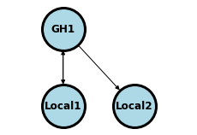
Cloning
To clone a remote repository is simply to copy it locally
If a repository is public
If you own it, then you can clone it and push changes back to the remote
If you don't, you can clone and pull changes, but then can't push back to the remote
Try with the course repo, clone it so you have access to the files
In the figure below the owner can pull and push to the repo
In the picture below, consider that you clone GH1 off of github to you. You can pull updates from GH1 but can't push changes to GH1. The owner of GH1 of course can pull and push
git clone https://github.com/smart-stats/ds4bio_book.git

Slide 12
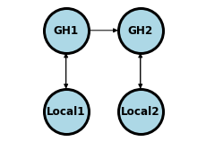
Forking
A common workflow for github is to "fork" the repository. This differs from cloning in the sense that your fork is an entirely separate new copy
In the picture below, GH2 is a fork of GH1. It can pull upstream changes from GH1, but can't write to it, since you don't own that repo. You can push and pull from Local2 which is connected to GH2.

Slide 13
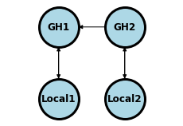
Pull requests
If you want your changes represented in GH1, recall you don't have write access to that repo
Example, you forked this repo and have great additions and changes you think should be represented for other students
You issue a pull request in the sense of requesting GH1 to pull your changes from GH2
I can then decide whether or not I'd like those changes pulled into my GH1 repo
I like to do pull requests directly on github through the web interface

Slide 14
Branching
You often want multiple version of a repository
Example a development version, a working version and a stable version
This is what branches are for in git
git checkout -b dev
creates a branch called dev and switches to that branch. If you already have dev, use checkout without -b
Suppose you want to merge your change from dev into your default branch (main)
git checkout main
git merge dev
Start very basic with branches, then when you get the hang of it you can use it like a pro
Here's documentation

